Slide 1

Cyber Defense Organization
Fall 2018 - Intro to Linux

Slide 2

PSA aka NEWS
Change facebook password Delete Facebook (Use the UAlbany reddit).
https://www.nytimes.com/2018/09/28/technology/facebook-hack-data-breach.html
Notes:
Talk about facebook attack

Slide 3

Small Term of the Week: Imposter Syndrome
Psychological pattern where an individual doubts their accomplishments, and has a persistent internalized fear of being exposed as fraud.
Notes:
Add picture

Slide 4
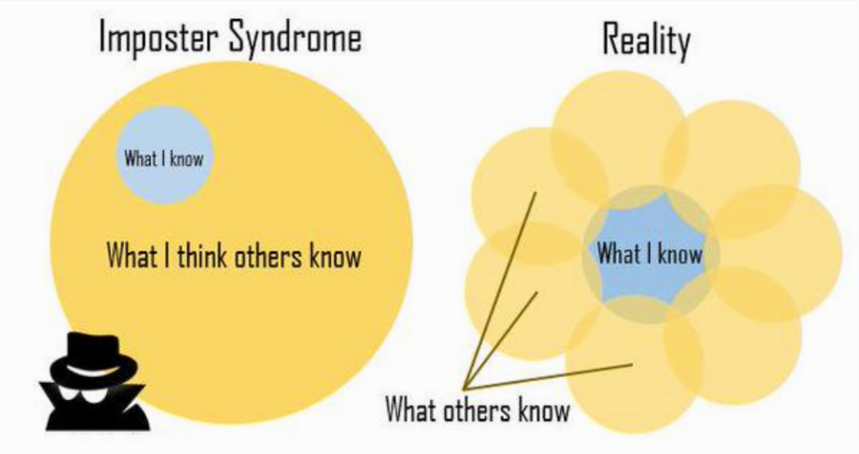
What is Imposter Syndrome?
Psychological pattern where an individual doubts their accomplishments, and has a persistent internalized fear of being exposed as fraud.
Coined in 1978, is described as a feeling of “phoniness in people who believe that they are not intelligent, capable or creative despite evidence of high achievement.” Basically, when you feel inadequate despite evident success.
Notes:
Imposter Syndrome is the You are at college, you have to motivation and drive to learn more and you are capable of achieving greatness.

Slide 5
Symptoms
Those who believe themselves to be impostors often attribute their accomplishments to luck. They may think, "I was in the right place at the right time" or "That was a fluke."
People with Impostor Syndrome think they're nothing special. Whatever they've achieved, others can too. They'll think to themselves, "Oh, that was nothing. I'm sure my teammate could have done the same thing" or "I don't offer anything special to the company that no one else could."
They may think, "This was really a team project. It wasn't all me" or "Since I didn't do this completely by myself, it doesn't really count as a success."
Use a lot of minimizing language because they don't feel fully confident, like "I'm pretty sure" or "I kind of think"
Notes:
Imposter Syndrome is the pYou are at college, you have to motivation and drive to learn more and you are capable of achieving greatness.

Slide 6
About me
$ Anthony Capece III
$ Junior@DigitalForensics
$ Vice-President@CyberDefenseOrganization
$ Interested in “Ethical” Hacking, Linux Security, Networking Security
Notes:
Name
Junior in Digital Forensics Program
Vice-President
If you are interested in any of these topics come and talk to me

Slide 7

Introduction to Linux
Introduce you to the fundamentals of Linux
Familiarize you with history of Linux
Groundwork for future workshops/competitions

Slide 8
About Linux
Linux is a Kernel
Operating Systems based off Linux Kernel
Ubuntu
Kali
CentOS
Fedora
Notes:
Linux is a kernel not necessarily an operating system. The Linux kernel is used to build operating systems such as Ubuntu, Kali, CentOS and Fedora. Also Android is built off the linux kernel.
Kernels in a very broad definition handle the interaction between the user and the hardware.

Slide 9
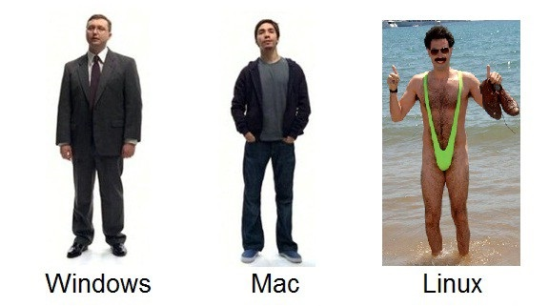
Why linux
Free and Open Source Software
Command Line Orientated
More Secure (REPOS) (apt, yum etc.)
Stripped Down
Run anything (Services)
Notes:
Free and Open Source
Linux is open source and it is FREE, meaning you can go on github and view the source code, freedom to use the software for any purpose, shareable (no product licenses)
Do whatever you want with it
---Command Line---
As opposed to windows, linux is primarily used through the command line. ALTHOUGH at any time you can just install a gui with one command (take that windows)
--More secure--
Repositories are trusted and signed packages of easy to download programs, one command. These are community maintained
Chrome to download (INSECURE)
Repository - trusted known packages updated
Windows - Unknown just download whatever link you click on
--Stripped down--
It only comes with the essentials usually no bloatware (OS installation changes this)

Slide 10
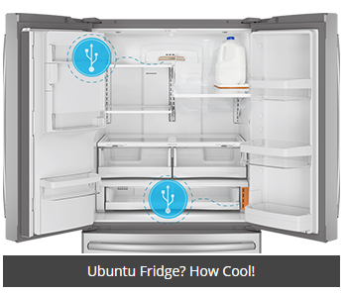
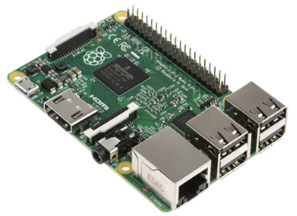
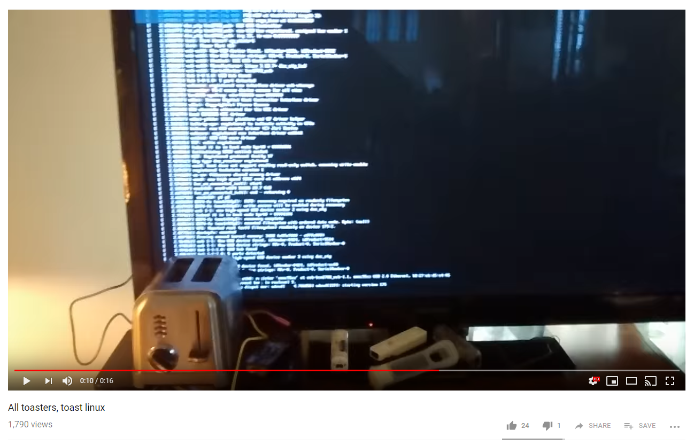

Why linux pt 2
POSIX (Portable Software)
Notes:
Raspberry Pi’s
Phones
Refrigerators
Even Toasters because why not

Slide 11
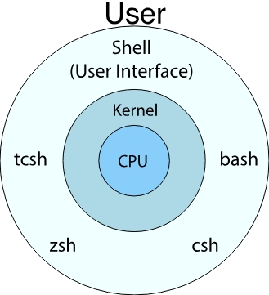
Shells
How you talk to the computer
Different versions
bash, zsh
Prompt:
username@hostname:current/directory$
Notes:
So a shell is essentially what takes what you do and hands it off to the operating system to perform.
This can be a command line or a GUI.
There is small differences between them, autocompletion of commands, directory aliases
Prompt is telling you that you can enter commands now

Slide 12
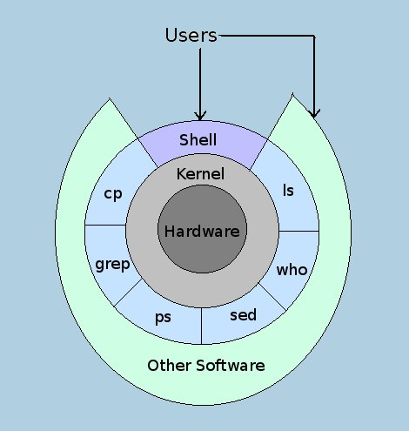
Shells pt2
Next Time: SSH
Notes:
I like this picture

Slide 13

Start em up
Open VirtualBox
Start the Ubuntu Machines
Password: bb123#123
Notes:
Capture the flag style linux workshop
Teaching commands through finding flags

Slide 14
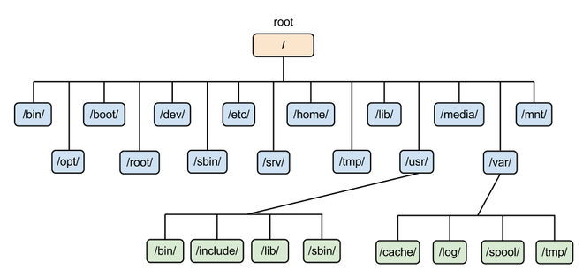
The Hierarchy
Notes:
/ = Root
/etc/ = directory for config files, basically describes how a program runs

Slide 15
The Hierarchy
/ - filesystem root
/bin - contains programs
/sbin - contains programs for admins
/etc - configuration files for programs
/opt - downloaded programs
/home - each user has files live there
/dev - attached devices information (usbs)
/var - variable files(LOGS!)
/tmp - temporary files
. - current directory
.. - go up one directory
- - go back
Notes:
/ = filesystem root being the absolute top of the filesystem
/bin = where the most basic binaries live, these are the executables or programs you run/type in at the terminal. Before the operating system loads these commands are available t Examples being ls, cp(copy), kill(kill process), dd(data definition- for imaging).
/sbin = binaries or programs that only a admin should be able to execute
/etc/ = directory for config files, basically describes how a program runs
/opt - OPTIONAL programs this could include firefox, skype, anything. Generally good practice
/home - where the user files live, each user gets their own folder here where they can put whatever they want
/dev - device files, terminal devices, usbs, adapters

Slide 16
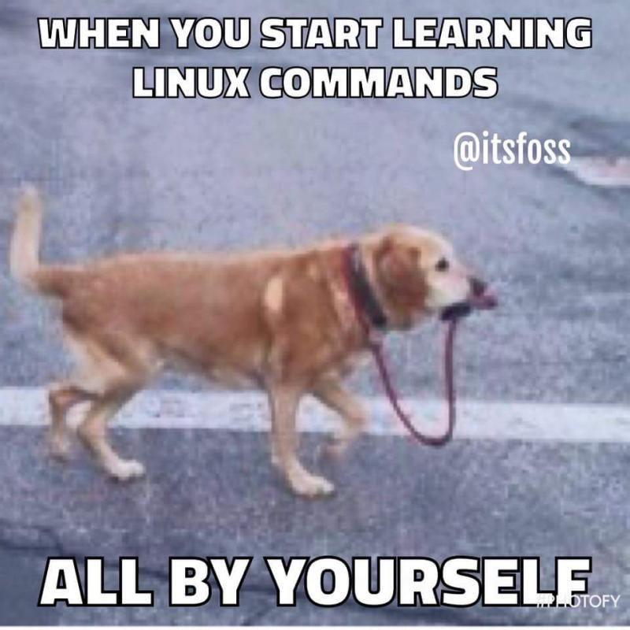
Getting around
pwd - print working directory, shows where you currently are in the system i.e the working directory
ls - list all the files in the current folder
-l : long-listing or more details
-a : list all files (including hidden)
cat - concatenate two files (usually used for printing contents of file)
cd - change directory you are in
cd ..
cd -

Slide 17
The Users and Groups
Users on linux denoted in /etc/passwd
Every user has a User Identification Number (UID)
Every group has a Group Identification Number (GID)
Notes:
You can view all the users on a system in /etc/passwd, this shows basic information on a user; dont get in depth on this
Every user has a identification number that is unique on that system
If I want people

Slide 18
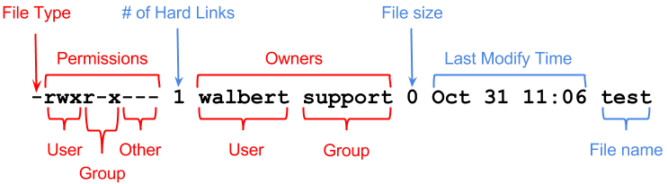
Permissions
000
421
Notes:
There is a octal way of representing this that I will go over in the future but this is to get everyone familiar
The Owner can read, write execute, the Owners primary group can read and execute and everyone else is shit outta luck

Slide 19
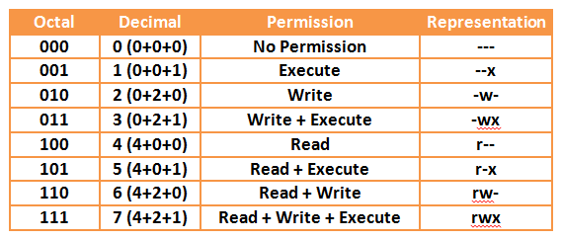
File Permissions Cont.

Slide 20
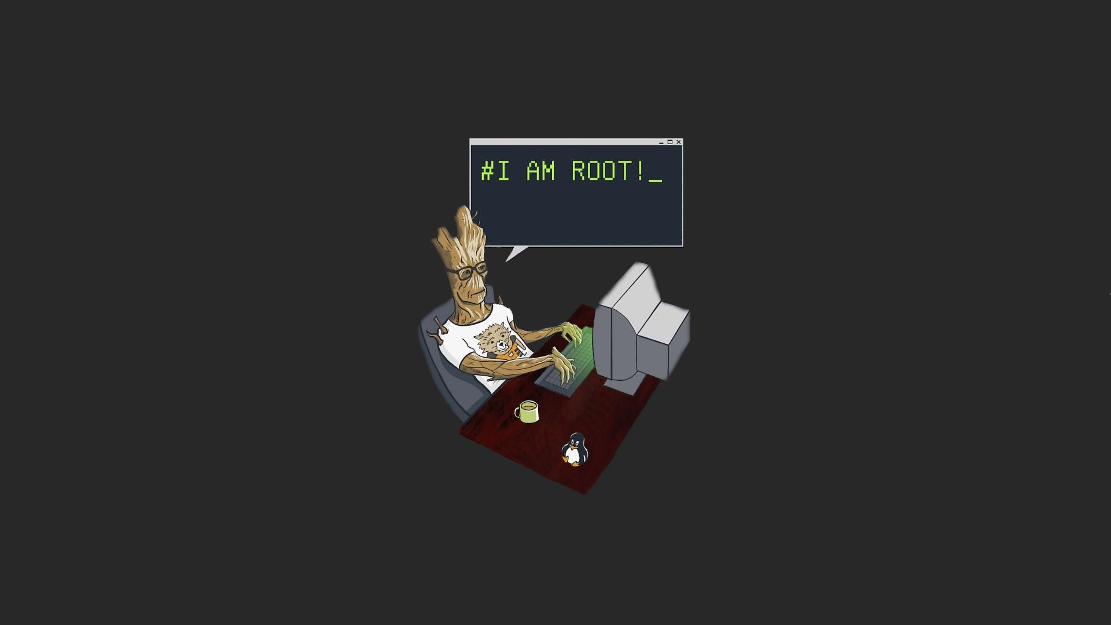
Permissions
ROOT - the user name or account that by default has access to all commands and files on a Linux
aka. root account, root user and the superuser.
sudo - Allow for non-privileged users to execute commands with root privileges.
Who can use sudo, /etc/sudoers
Notes:
By default on Ubuntu systems Root user login is blocked
Sudo means super user do

Slide 21
File management
chmod - change file permissions; octal or rwx
chown - change owner / group of files
Notes:
This can be done using octal or

Slide 22
User Management
useradd - add new user
useradd {username}
deluser - delete user
deluser {username}
groupadd - create new group
groupadd {group}
groupdel - delete group
groupdel {group}
whoami - show logged in
who - who else is logged in

Slide 23
Creating and Destroying
echo - write standard input to output
touch - Allows you to make an empty file.
touch file
mkdir - Creates (makes) a directory or folder.
mkdir memes
rm (rmdir) - remove files / directories

Slide 24
QUESTIONS?

Slide 25
How the heck do you manage all that?
<ctrl-c> : kill current process
<ctrl-z>: put current process in background
<tab>: complete the command
!!: re-run recent command
jobs : view background processes
history - view recent commands
clear - clear the screen
Notes:
For jobs you can use fg %procid% to bring it back

Slide 26
Où est?
find - finding files
grep - search files / folders
which - find binaries

Slide 27
Find
find a file on the ROOT directory named “flag.txt”
HINT: sudo
find - used to find files
find {location} {options}
man {command}
Examples:
-type f,l,d,c,b
-user {username} - find all files owned by {username}
-group {group} - find all files owned by {group}
-perm ### : find all files with ### permissions
find a directory on the ROOT directory “flag_challenge”
Notes:
-type f(ile),l(ink),d(irectory),c(character block),b(lock device)
Have everyone find flag
cd into directory
cat to open file

Slide 28
grep
grep - used for advanced text/file/folder filtering grep {options} {pattern} {file} grep -i “string” file.txt
Examples: -i {case insensitive} -w {only whole word} -c {count number of matching lines / suppresses output}

Slide 29
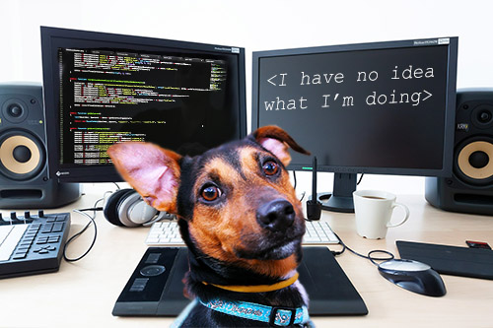
Need Help?
man - User manual for Linux distributions
man {option}
man find
If you keep getting an error on the command you are typing, always check the manual to see if you are doing it correctly.

Slide 30

Edit Stuff
Nano - terminal based text editor. Nano is ideal for making small changes to existing configuration files or for writing short plain text files.
Vim- Another terminal based text editor. Vim is much more common and powerful compared to nano.

Slide 31
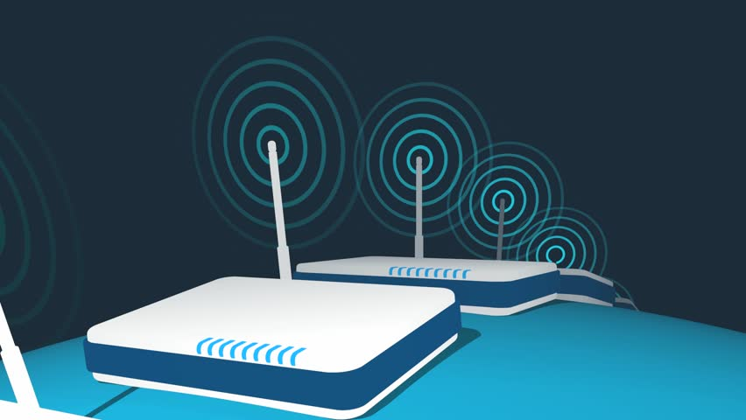
Other useful Linux commands that will be more relevant next week
nslookup
tcpdump
netstat
ifconfig

Slide 32
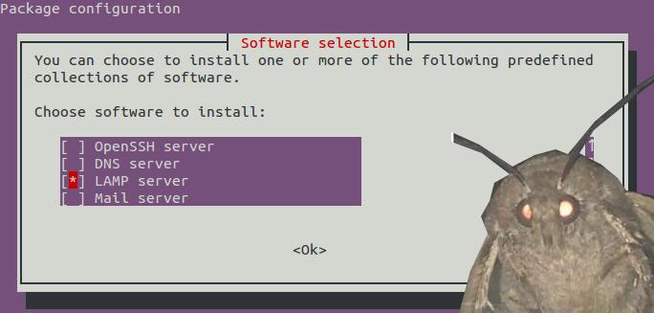
Services
Linux can run
Web Server, DNS, DHCP, Mail, FTP, MYSQL, Anything
Notes:
On Windows usually (correct me if i am wrong) the windows machine is either a server OR a client.

Slide 33
Next time linux
Log analysis
Process monitoring
Managing services & Networking with Linux
Linux security

Slide 34
Linux Resources:
Over the wire - Practice Linux Navigation through SSH.
http://overthewire.org/wargames/
Linux Academy - Practice for CTF, Certifications, Hands-on Labs
https://linuxacademy.com/

Slide 35
Announcements
Working on an interesting project? Have a specialty? Present
If you are interested in a topic/want to present email us! Cyber
Notes:
We are trying to get members involved, we want all of you to share your knowledge and interest with us.

Slide 36
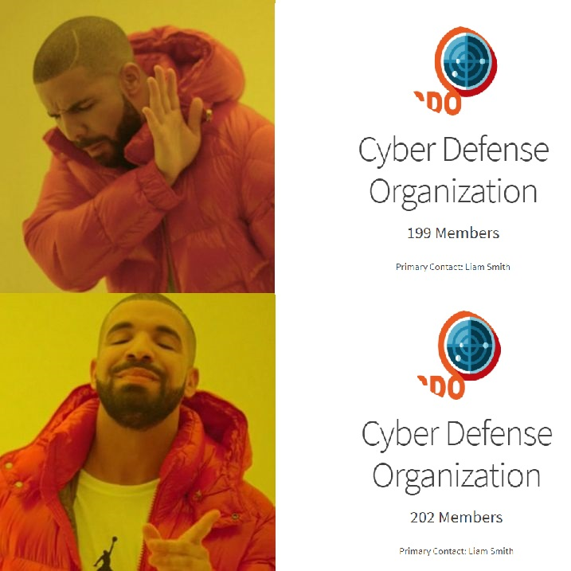

Slide 37
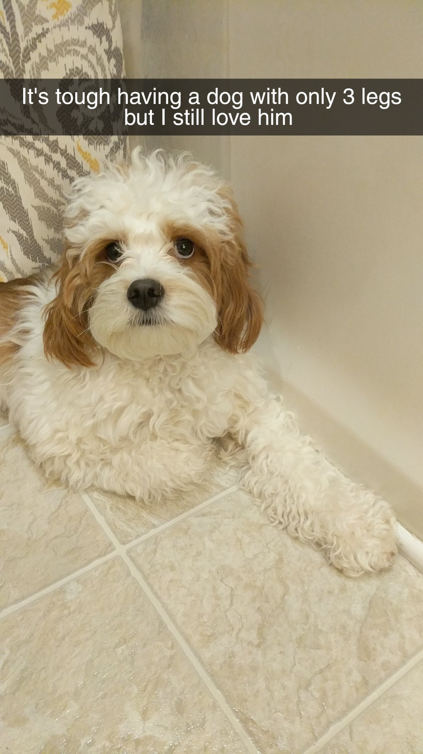


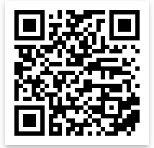
Cya Next week!
Thank you to everyone who filled out the survey!
mlim@albany.edu
Follow us on Twitter? Add on myInvolvement?
Grey Castle speakers - Tuesday 7:15? BB129
CCDC! - Monday 7:30
BB123 (Check email).
Introduction to Networking
- Friday 3pm BB123

